Slide 1
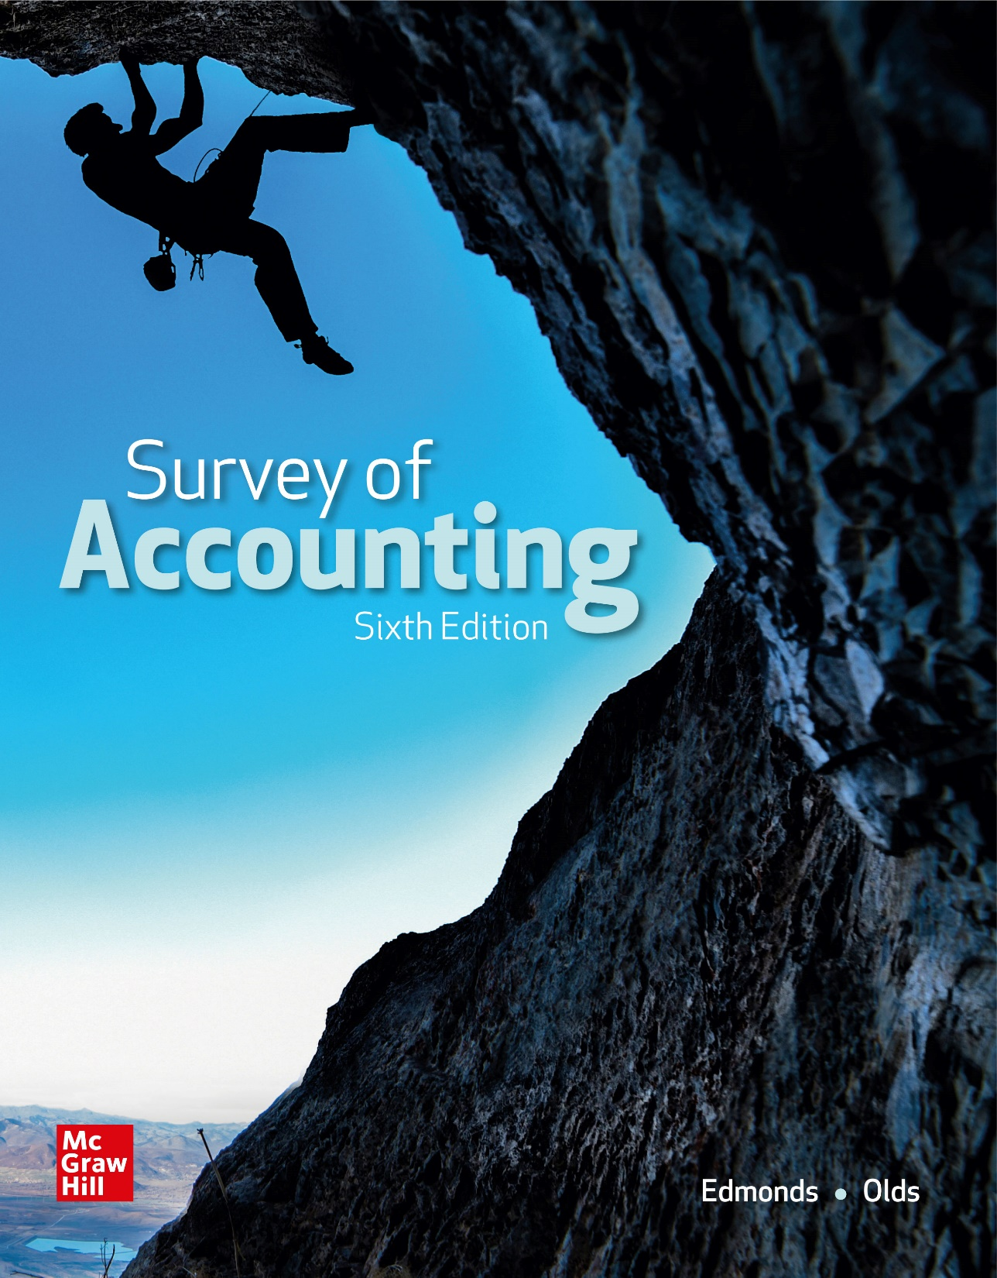
Chapter 4
Internal Controls, Accounting for Cash, and Ethics

Slide 2
LO 4-1:
Identify the key elements of a strong system of internal control.

Slide 3
Key Features of Internal Control Systems
Control Environment
The integrity and ethical values of the company, including its code of conduct and other actions that set the tone of the organization
Risk Assessment
Management’s process of identifying potential risks that could result in misstated financial statements and addressing those risks.

Slide 4
Key Features of Internal Control Systems
Control Activities
The activities usually thought of as “the internal controls” including segregation of duties, account reconciliations, and information processing controls designed to safeguard assets and enable an organization to timely prepare reliable financial statements.

Slide 5
Key Features of Internal Control Systems
Information and Communication
The internal and external reporting process, and includes an assessment of the technology environment.
Monitoring
Assessing the quality of a company’s internal control over time and taking actions as necessary to ensure it continues to address the risks of the organization.

Slide 6
Internal Controls
Separation of Duties
Quality of Employees
Bonded Employees
Required Absences
Procedures Manual
Authority and Responsibility
Prenumbered Documents
Physical Control
Performance Evaluations
Limitations

Slide 7
Separation of Duties
When duties are separated, the work of one employee can act as a check on the work of another employee.
The likelihood of fraud or theft is reduced if collusion is required to accomplish it.

Slide 8
Quality of Employees
A business is only as good as the people it employs. Employees should be properly trained to perform a variety of tasks.
Job rotation and cross training prevent disruptions, may help relieve boredom, and increase productivity.

Slide 9
Bonded Employees
Employers should screen job applicants using interviews, background checks and recommendations. Employees in positions of trust should be bonded.
Fidelity bond
Provides insurance that protects a company from loss caused by employee dishonesty.

Slide 10
Required Absences
An employee may be able to cover up fraudulent activities if they are always present at work. All employees should be required to take regular vacations and their duties should be rotated periodically.

Slide 11
Procedures Manual
Appropriate accounting procedures should be documented in a procedures manual.
The manual should be routinely updated. Periodic reviews should be conducted to ensure that employees are following the procedures outlined in the manual.

Slide 12
Authority and Responsibility
Businesses should prepare an authority manual that establishes a definitive chain of command.
Specific authorizations apply to specific positions, while general authority applies across different levels of management.

Slide 13
Prenumbered Documents
Prenumbered forms are used for all important documents such as checks, purchase orders, receiving reports, and invoices. The use of prenumbered forms helps keep track of all forms issued during a particular period.

Slide 14
Physical Control
All companies should maintain adequate physical control over valuable assets that may be misappropriated.
For example, inventory should be properly stored in a secure location. Serial numbers should be placed on all valuable assets to assist in a physical count of these assets.

Slide 15
Physical Control
To limit losses, companies should establish adequate physical control over valuable assets.
Inventory should be kept in a storeroom and not released without proper authorization
Serial numbers on equipment should be recorded along with the name of the individual responsible
CDs and marketable securities should be kept in fireproof vaults.

Slide 16
Performance Evaluation
Internal controls should include independent verification of employee performance.
A physical inventory should be taken at least annually by someone other than the person who has control over the inventory.
Auditors should evaluate the effectiveness of the control system as well as verify the accuracy of the accounting records.

Slide 17
Limitations
Internal controls can be circumvented by collusion among employees. Two or more employees working together can hide embezzlement by covering for each other. No system can prevent all fraud. Good internal controls minimize fraud and increase likelihood of early detection.

Slide 18
LO 4-2:
Identify special internal controls for cash.

Slide 19
Accounting for Cash
For financial reporting purposes, cash generally includes currency and other items that are payable on demand, such as checks, money orders, bank drafts and certain savings accounts.
Companies must maintain a sufficient amount of cash to pay employees, suppliers and other creditors.
When a company fails to pay its legal obligations, its creditors can force the company into bankruptcy.

Slide 20
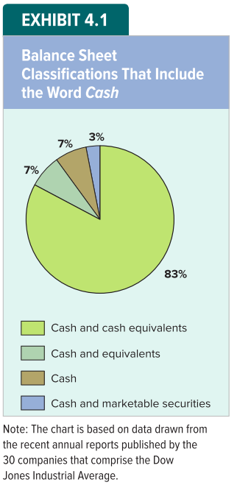
Cash and Cash Equivalents
Most companies combine currency and other payable on demand items in a single balance sheet account with varying titles.

Slide 21
Controlling Cash – Cash Receipts
A record of all cash collections should be prepared immediately upon receipt.
The amount of cash on hand should be counted regularly.
Employees who receive cash should give customers a copy of a written receipt.
Cash receipts should be deposited in a bank on a timely basks.
Every effort should be made to minimize the amount of cash on hand.

Slide 22
Controlling Cash – Cash Payments
A company should make all disbursements using checks, thereby providing a record of cash payments.
All checks should be prenumbered, and unused checks should be locked up.
The duties of approving disbursements, signing checks, and recording transactions should be separated.
Supporting documents should be required and marked Paid when the check is signed.

Slide 23
Controlling Cash – Cash Payments
A company should make all disbursements using checks, thereby providing a record of cash payments.
All checks should be prenumbered, and unused checks should be locked up.
The duties of approving disbursements, signing checks, and recording transactions should be separated.
Supporting documents should be required and marked Paid when the check is signed.

Slide 24
Checking Account Documents
A bank signature card shows the bank account number and the signatures of the people authorized to sign checks.
Each deposit of cash or checks is accompanied by a deposit ticket.
When signed by the authorized person, a bank check authorizes the bank to transfer the face amount of the check from the payer’s account to the payee.

Slide 25
Bank Statement
Bank statements normally report
The beginning balance of the account
Additions for customer deposits
Other additions
Subtractions for the payment of checks
Other subtractions
A running balance
The ending balance of the account

Slide 26
LO 4-3:
Prepare a bank reconciliation.

Slide 27
Reconciling the Bank Account
Usually the ending balance reported on the bank statement differs from the balance in the depositor’s cash account as of the same date. The discrepancy is normally attributable to timing differences. Companies prepare a bank reconciliation to explain the differences between the cash balance reported on the bank statement and the cash balance recorded in the depositor’s accounting records.

Slide 28
Determining True Cash Balance
A bank reconciliation normally begins with the cash balance reported by the bank (the unadjusted bank balance).
The adjustments necessary to determine the amount of cash that the depositor actually owns as of the date of the bank statement are then added to and subtracted from the unadjusted bank balance.
The final total is the true cash balance.

Slide 29
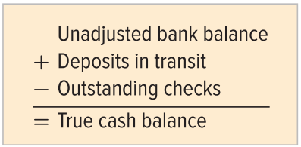
Adjustments to the Bank Balance
Deposits in transit have been recorded in the depositor’s accounting records but have not yet been added to the depositor’s account by the bank.
Outstanding checks are disbursements that have been properly records as cash deductions on the depositor’s books but the bank has not deducted the amounts from the depositor’s bank account.

Slide 30
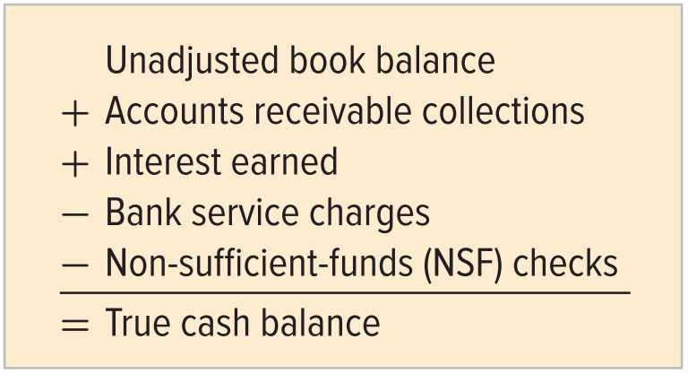
Adjustments to the Book Balance
A typical format for determining the true cash balance beginning with the unadjusted book balance is as follows:

Slide 31
Adjustments to the Book Balance
Accounts receivable collections are when customers send payments directly to the bank.
The amount of interest earned is added directly to the depositor’s bank account.
Banks frequently charge depositors fees (service charges) for services performed.
Non-sufficient-funds (NSF) checks are obtained from the company’s customers and deposited, however when submitted for payment the banks refuse due to insufficient funds.

Slide 32
Correction of Errors
If an error is found on the bank statement, an adjustment for it is made to the unadjusted bank balance to determine the true cash balance, and the bank is notified. An error made by the depositor requires an adjustment to the book balance.

Slide 33
Certified Checks
A certified check is guaranteed payment by the bank and is deducted when the bank certifies that the check is good. They, therefore, have been deducted by the bank in determining the unadjusted bank balance.

Slide 34
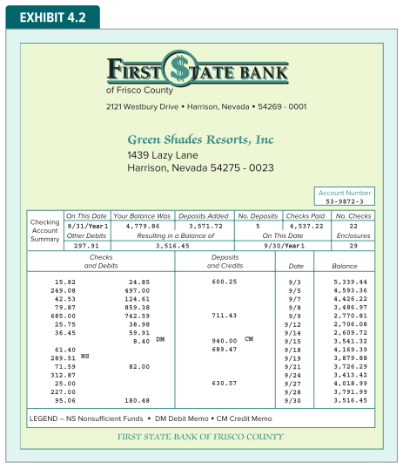
Bank Statement for Green Shades Resorts, Inc.

Slide 35
Adjustments to the Bank Balance
The September 30, Year 1 bank statement showed an unadjusted balance of $3,516.45. A review of the bank statement disclosed three adjustments:
Comparing the deposits on the bank statement with deposits recorded in the accounting records indicated there was $724.11 of deposits in transit.
An examination of the returned checks disclosed that the bank has erroneously deducted a $25 check written by another company.
The checks returned with the bank statement were compared to the cash records. Three checks with amounts totaling $235.25 were outstanding.
After these adjustments are made, GSRI’s true cash balance is determined to be $4,030.31

Slide 36
Adjustments to the Book Balance
GSRI’s unadjusted book balance as of September 30, Year 1 was $3,361.22. This balance differs from GSRI’s true cash balance because of four unrecorded accounting events:
The bank collected a $940 account receivable for GSRI.
GSRI’s accountant made a $27 recording error.
The bank charged GSRI an $8.40 service fee.
GSRI had deposited a $289.51 check from a customer who did not have sufficient funds to cover the check.
Two of these adjustments increase the unadjusted cash balance while the other two decrease the unadjusted cash balance. The true balance determined from the perspective of the bank statement agrees with the true balance determined from the perspective of GSRI’s books.

Slide 37
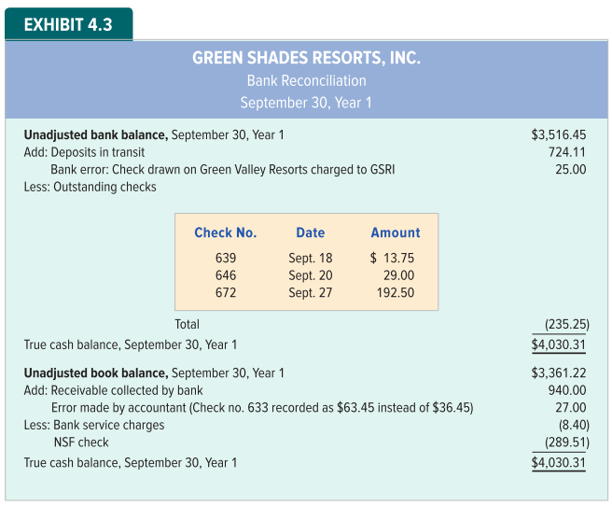
GSRI Bank Reconciliation

Slide 38
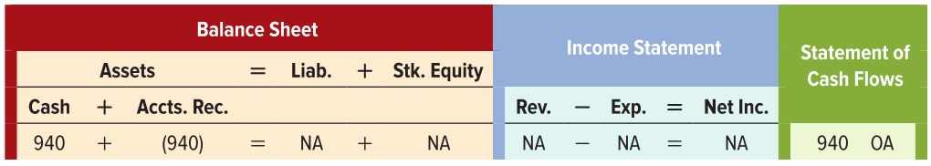
Updating GSRI’s Accounting Records
Each of the adjustments to the book balance must be recorded in GSRI’s financial records. The effects of each adjustment on the financial statements are as follows:
Adjustment 1: Recording the $940 receivable collection increases cash and reduces accounts receivable.
Asset Exchange Transaction

Slide 39
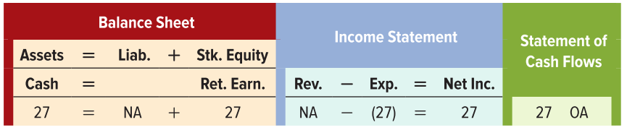
Updating GSRI’s Accounting Records
Each of the adjustments to the book balance must be recorded in GSRI’s financial records. The effects of each adjustment on the financial statements are as follows:
Adjustment 2: Assume the $27 recording error occurred due to transposing two numbers when recording check #633 for utilities expense

Slide 40
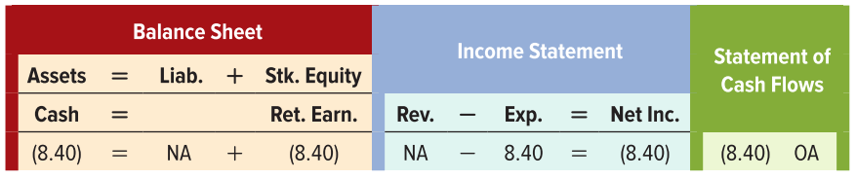
Updating GSRI’s Accounting Records
Each of the adjustments to the book balance must be recorded in GSRI’s financial records. The effects of each adjustment on the financial statements are as follows:
Adjustment 3: The $8.40 service charge is an expense that reduces assets, stockholders’ equity, net income, and cash.

Slide 41
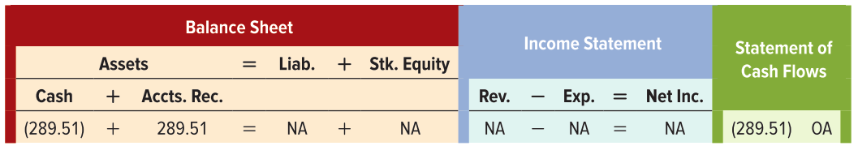
Updating GSRI’s Accounting Records
Each of the adjustments to the book balance must be recorded in GSRI’s financial records. The effects of each adjustment on the financial statements are as follows:
Adjustment 4: The $289.51 NSF check reduces GSRI’s cash balance.

Slide 42
LO 4-4:
Identify the role of ethics in the accounting profession.

Slide 43
Importance of Ethics
The accountant’s role requires trust and credibility.
Accounting information is worthless if the accountant is not trustworthy.
Therefore, the accounting profession requires high ethical standards.

Slide 44
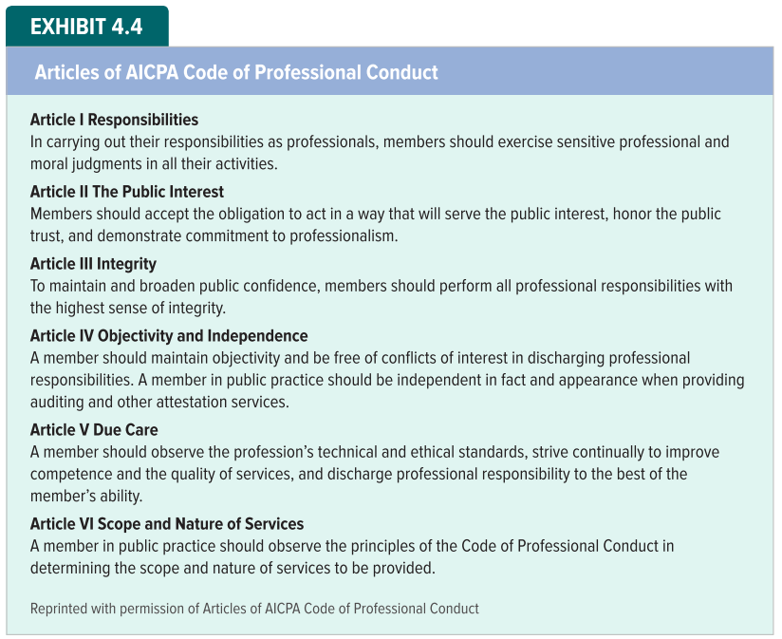
AICPA Code of Professional Ethics

Slide 45
Common Features of Criminal and Ethical Misconduct
It takes more than a code of conduct to stop fraud. People frequently engage in activities that they know are unethical or even criminal. The auditing profession has identified three elements that are typically present when fraud occurs:
The availability of an opportunity.
The existence of some form of pressure leading to an incentive.
The capacity to rationalize.
The three elements are frequently arranged in the shape of a triangle.

Slide 46
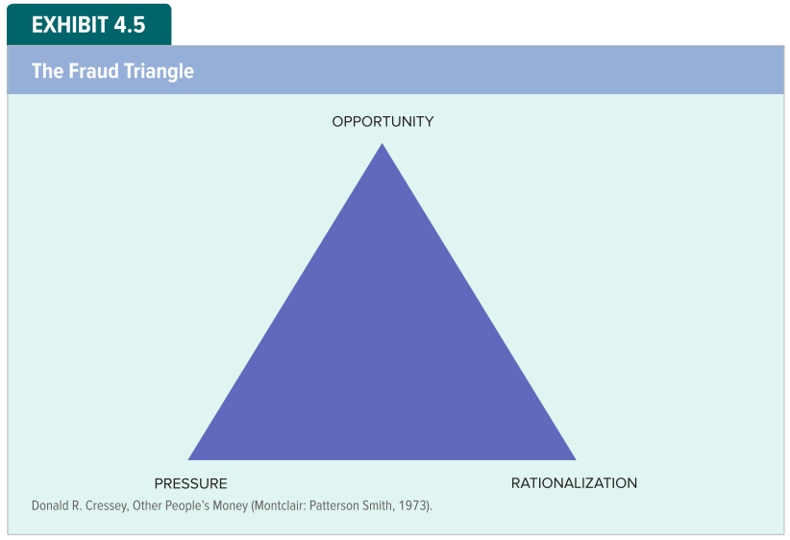
Common Features of Criminal and Ethical Misconduct — The Fraud Triangle

Slide 47
LO 5:
Identify the auditor’s role in financial reporting.

Slide 48
Role of the Independent Auditor (CPA)
Conducts a financial audit.
Assumes both legal and professional responsibilities to the public as well as to the company paying the auditor.
Determines if financial statements are materially correct.
Presents conclusions in an audit report that contains an opinion.
Maintains professional confidentiality of client records.

Slide 49
The Financial Statement Audit
There are several types of audits. The type most relevant to this course is a financial statement audit.
A detailed examination of a company’s financial statements and the documents that support those statements.
It also tests the reliability of the accounting system.
A financial audit is conducted by an independent auditor, who must be a CPA.

Slide 50
Materiality and Financial Audits
Auditors do not guarantee that financial statements are absolutely correct—only that they are materially correct.
Material Item
An error, or other reporting problem, that would influence the decision of an average prudent investor.

Slide 51
Types of Audit Opinions
Once an audit is complete, the auditors present their conclusions is a report that includes an audit opinion. There are three types of audit opinions:
An unqualified opinion means the auditor believes the financial statements are in compliance with GAAP without qualification, reservation or exception.
An adverse opinion means that one or more departures from GAAO are so material that the financial statements do not present a fair picture of the company’s status.
A qualified opinion means that, for the most part, the company’s financial statements are in compliance with GAAP, but the auditors have reservations about something in the statements.

Slide 52
Confidentiality
The confidentiality rules in the AICPA’s code of ethics prohibits auditors from voluntarily disclosing information they have acquired as a result of their accountant-client relationships.
However, accountants may be required to testify in a court of law.
In general, federal law does not recognize an accountant-client privilege as it does with attorneys and clergy.

Slide 53
End of Chapter 4

